Slide 1
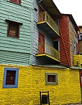
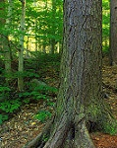
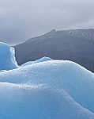
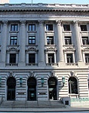
Neural network for Landmarks classification
Amal ALSHAHRANI

Slide 2
Introduction :
Images plays an important part of our lifestyle .every scene around us can be depicts as a picture . Where a lot of people are fan of picturing , and I am one of them .
From this prospective , I have investigated with what I learned in deep learning.
Inspiration :
I inspired to build powerful Neural network that can classify these images with more accuracy , to classify landmarks .image processing considered one of the most famous application in Deep learning.

Slide 3
Contents :
Introduction
Data description
Simple Neural Network (baseline)
Convolutional Neural Network
processed- images
Accuracy comparison

Slide 4
data description
The source : This data was initially published on https://datahack.analyticsvidhya.com .
The obtained pictures are about 14k images in Train, 3k in Test and 7k in Prediction.
The size around 150x150 pixels , distributed under 6 categories.
buildings':0 ,'forest':1,'glacier':2,'mountain':3,'sea':4,'street':5

Slide 5
Data distribution : - for training images = 3500 images for testing images = 7250 images -
The data is balanced

Slide 6



Tools :

Slide 7

simple neural network
77.32 52.03 | Train Accuracy (test)

Slide 8
Convolutional neural network
A convolution layer is a specific kind of layer architecture. Whereas fully-connected , CNNs are "feed-forward neural networks“. that use filters and pooling layers.

Slide 9
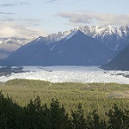
image pre-processing - resizing . - compression - converting to arrays

Slide 10
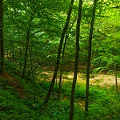
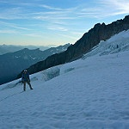
1- forest 2- glacier

Slide 11
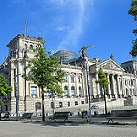

3-building 4- sea

Slide 12
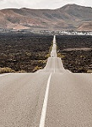
5- The street

Slide 13
Modeling :
1- data setup, converting the input to NumPy arrays
2- feed it to keas as input and output.
3- compiling the model , using Adam optimizer.

Slide 14
Modeling :
4- determine the specific metric (Accuracy )
5- train the model , with various numbers of epochs .
6- obtaining the (Model Loss) , (Accuracy )

Slide 15
Accuracy :
Based on : - layers - SoftMax (output function ) - activation='relu'
Training :0.86
Test :59.5

Slide 16
In conclusion:
The satisfied accuracy was obtained with Deep CNN model which = 59.03

Slide 17
Future work
1- Enhancing the accuracy .
2 – supporting my laptop with Graphics Processing Unit.

Slide 18
Thanks for your attention

